Slide 1
LIST OF JAVA FRAME WORKS
Following are the list of java frame works
Spring boot
Mvc frame work
JPA/Hibernate
Rest API
API CRUD
Data base
Object relational mapping (ORM)

Slide 2
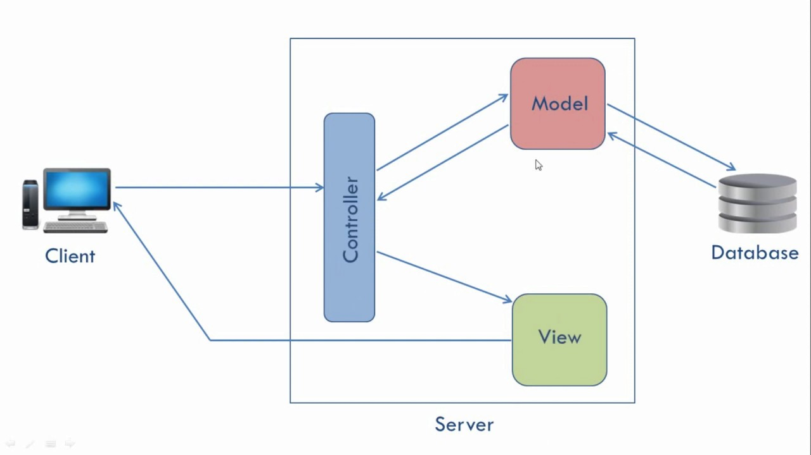

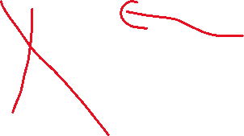
MVC ARCHTECTURE Block Diagram of MVC

Slide 3
As per the above block diagram mvc stands for model view controller.
Its is an architectural pattern.
Mvc divides a software application in 3 parts :- model, view & controller.
The MVC pattern helps you break up the frontend and backend code into separate components. This way, it's much easier to manage and make changes to either side without them interfering with each other.
Faster development process: MVC supports rapid and parallel development.
Ability to provide multiple views.
The modification does not affect the entire mode.
MVC model returns the data without formatting.

Slide 4
FOLLOWING ARE THE MAJOR ELEMENTS OF MVC
Model
View
Controller
Model (data)
The model's job is to simply manage the data. Whether the data is from a database, API, or a JSON object, the model is responsible for managing it.
Views (UI)
The view's job is to decide what the user will see on their screen and generates UI for user.
Controller (Brain)
The controller's responsibility is to pull, modify, and provide data to the user. Essentially, the controller is the link between the view and model.
Through getter and setter functions, the controller pulls data from the model and initializes the views.
If there are any updates from the views, it modifies the data with a setter function.

Slide 5
IMPORTANT KEY WORDS IN JAVA
Following are the important keywords in java
web server
Web frame work
Hypertext transfer protocol (HTTP)
Application programming interface (API)
Integrated development environment (IDE)
JSON
Uniform resource locators (URL)

Slide 6
Web server
Web server is a software & hardware that uses (Http) & other protocols to respond to client requests made over world wide.
The main job of web server is to display website content through storing processing & delivering WebPages to users.
Web frame work
Web frame work is a software library that enables developers to write software that runs on the web.
HTTP
Hypertext Transfer Protocol (HTTP) is an application-layer protocol for transmitting hypermedia documents, such as HTML. It was designed for communication between web browsers and web servers, but it can also be used for other purposes.
API
Api define the way of communication among various activities like database connection ,networking &much more.

Slide 7
Integrated development environment (IDE)
An integrated development environment (IDE) is a software application that helps programmers develop software code efficiently. It increases developer productivity by combining capabilities such as software editing, building, testing, and packaging in an easy-to-use application.
JSON
JSON stands for JavaScript Object Notation . JSON is a lightweight data-interchange format . JSON is plain text written in JavaScript object notation.
Uniform resource locators (URL)
URL stands for Uniform Resource Locator. A URL is nothing more than the address of a given unique resource on the Web. In theory, each valid URL .

